Slide 1
DLD Lecture 2 Number System
Engr. M Kariz Kamal E: kariz<dot>kamal@nu<dot>edu<dot>pk

Slide 2
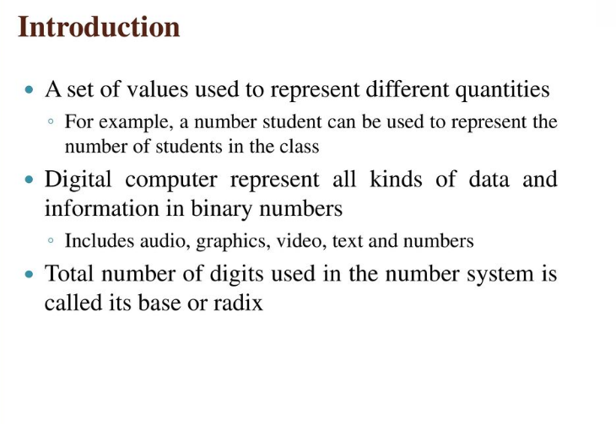

Slide 3
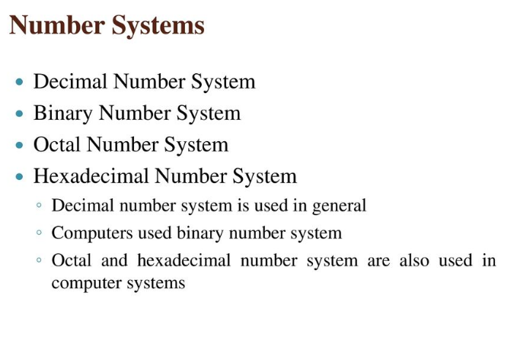

Slide 4
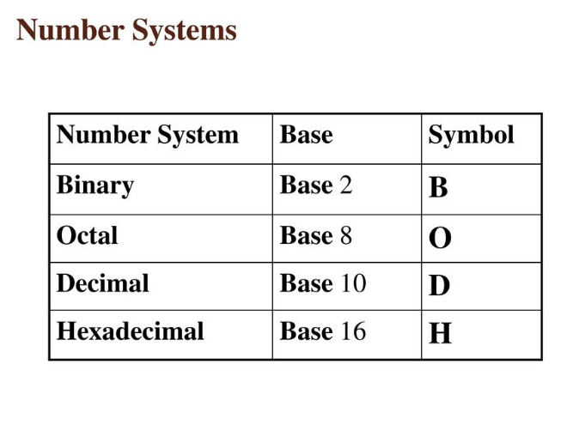

Slide 5
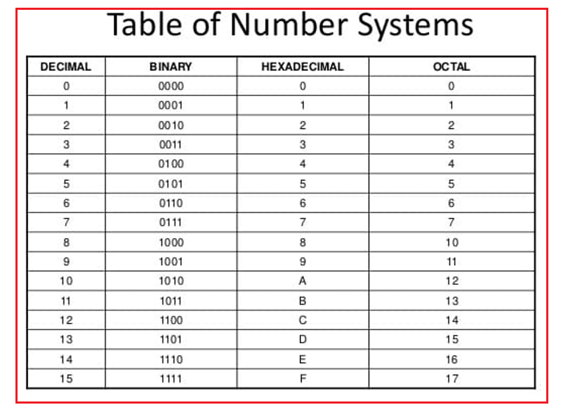

Slide 6
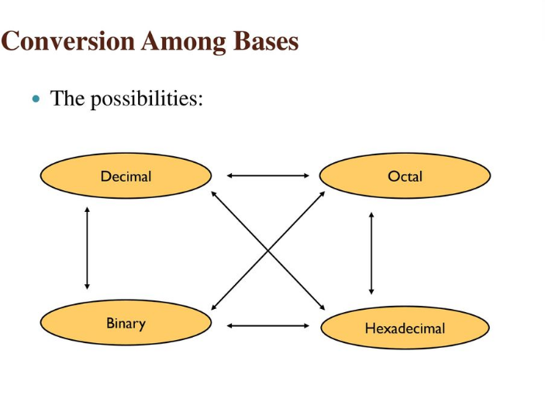

Slide 7
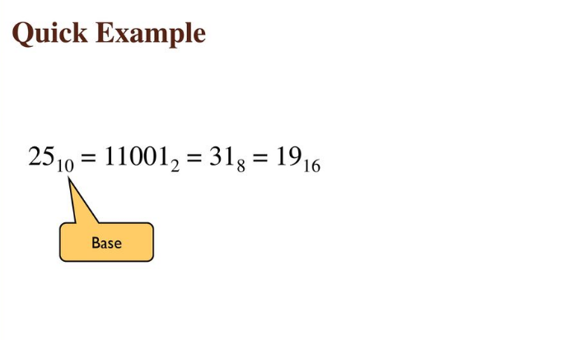

Slide 8
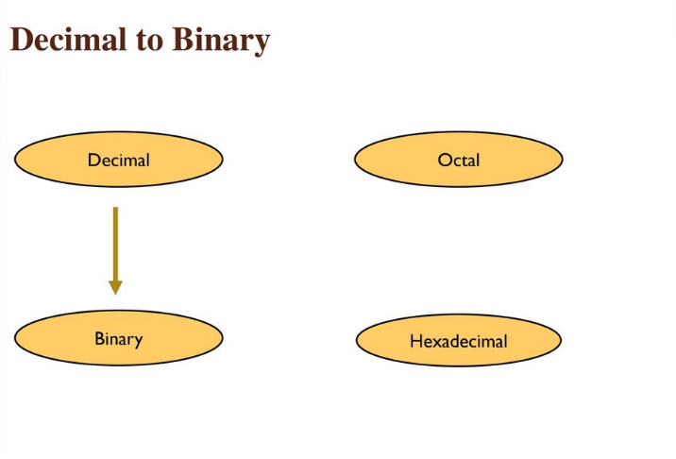

Slide 9
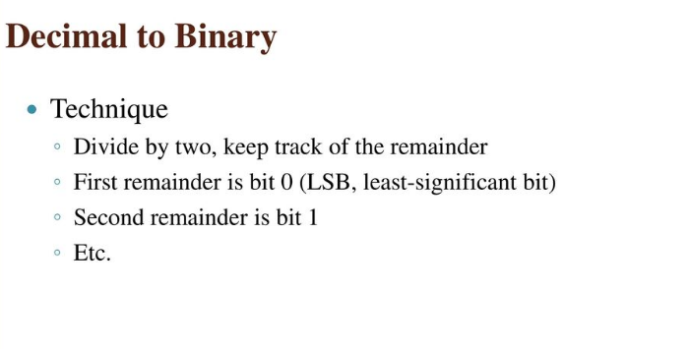

Slide 10
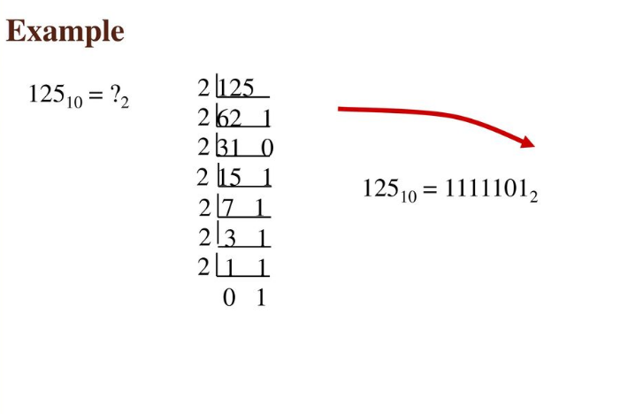

Slide 11
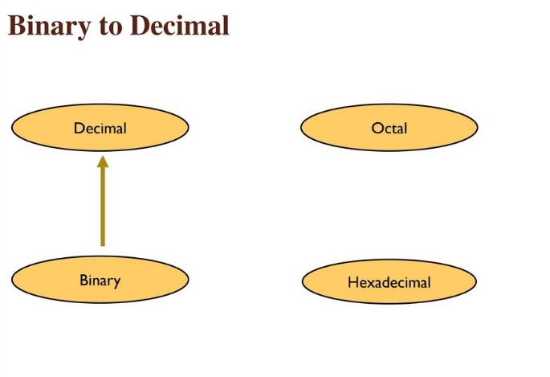

Slide 12
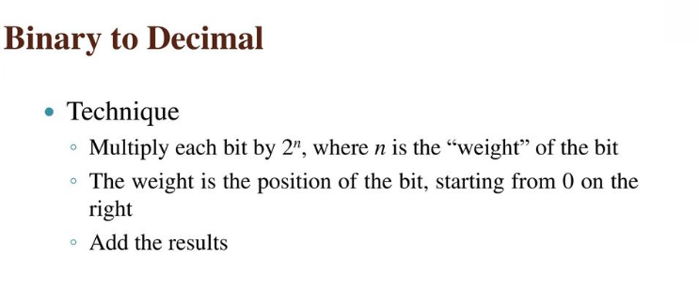
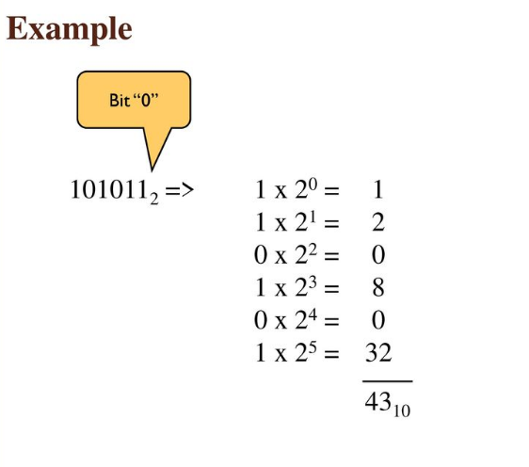

Slide 13
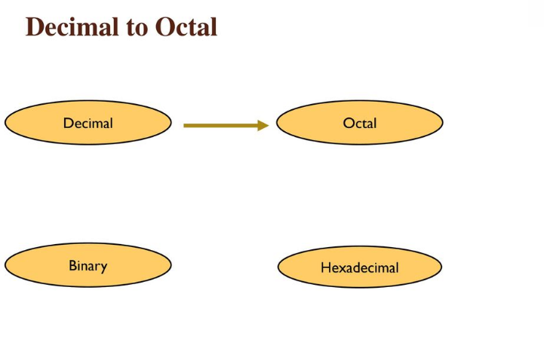

Slide 14
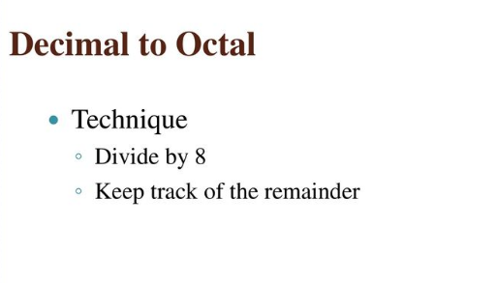
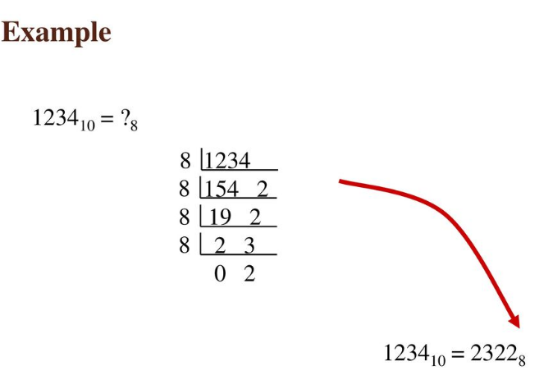

Slide 15
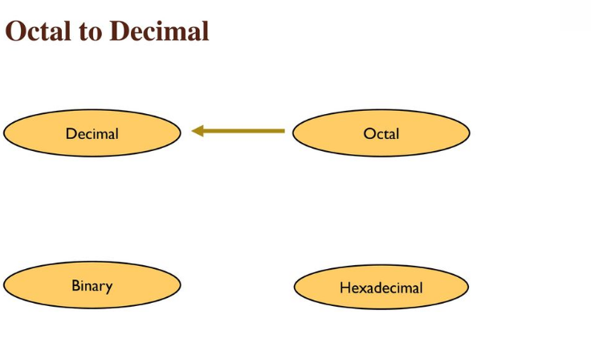

Slide 16
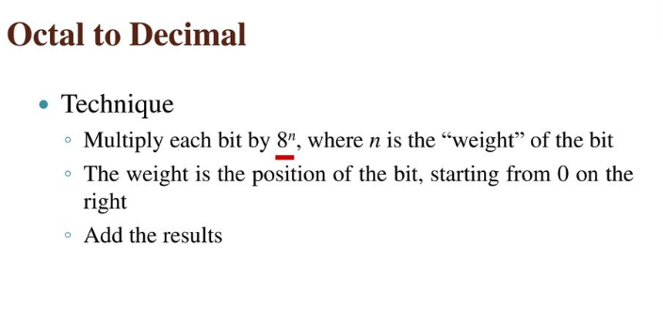
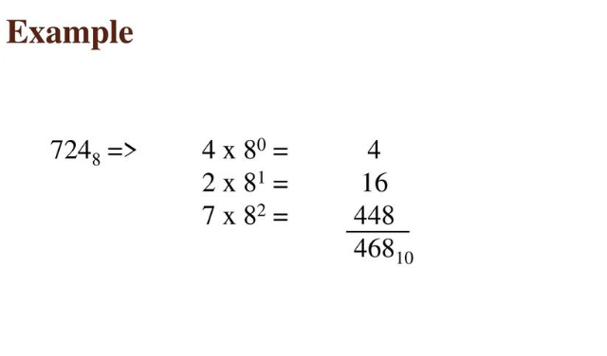

Slide 17
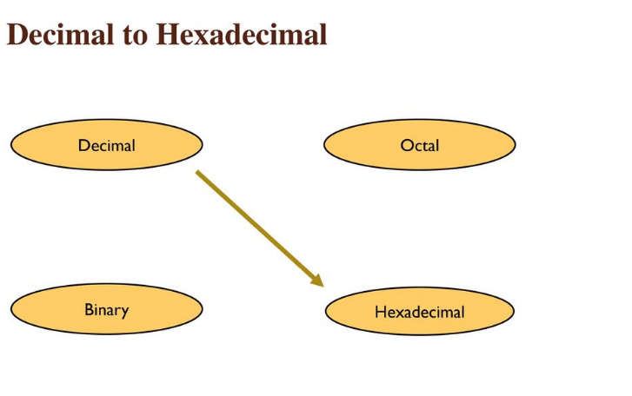

Slide 18
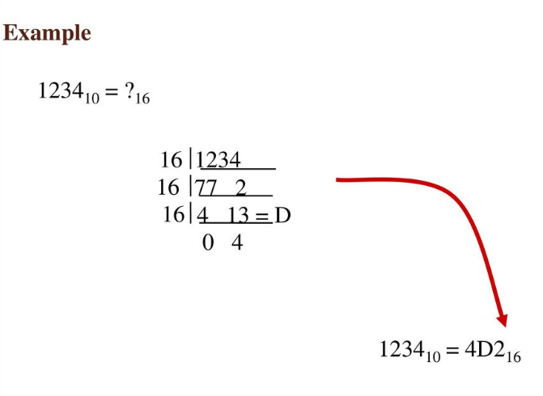
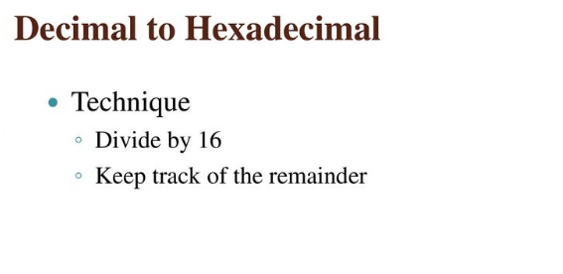

Slide 19
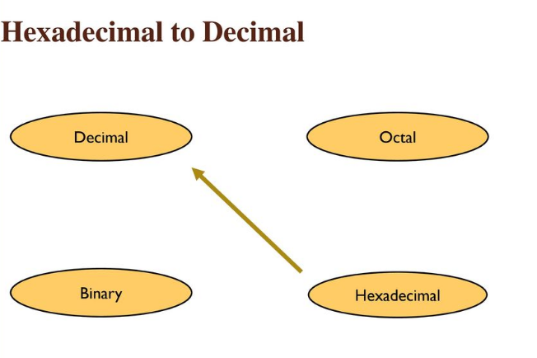

Slide 20
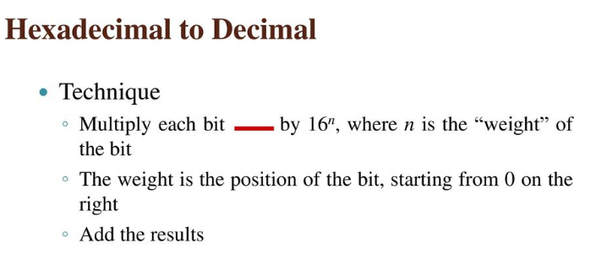
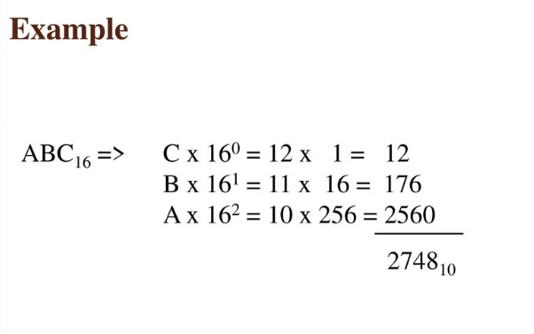

Slide 21
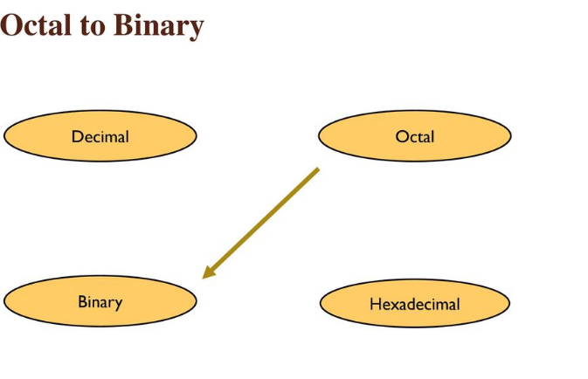

Slide 22
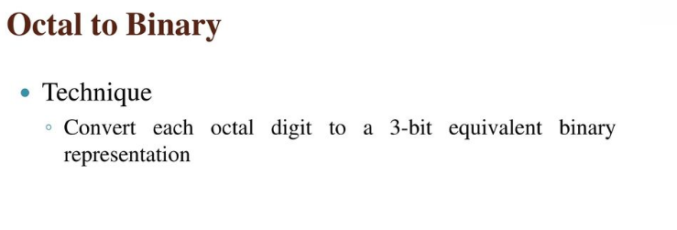
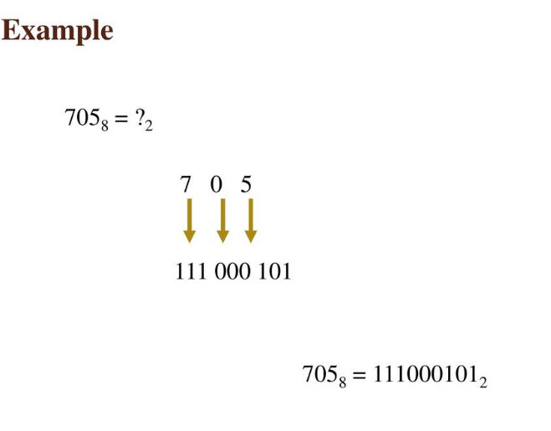

Slide 23
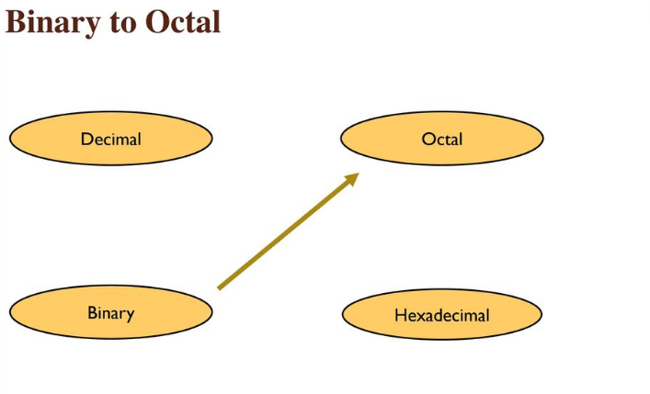

Slide 24
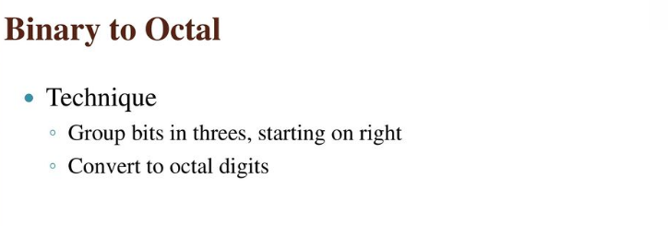
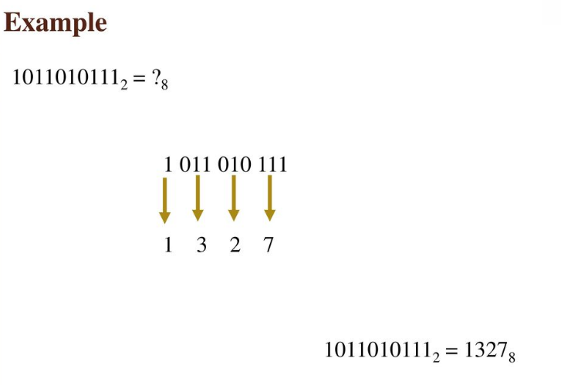

Slide 25
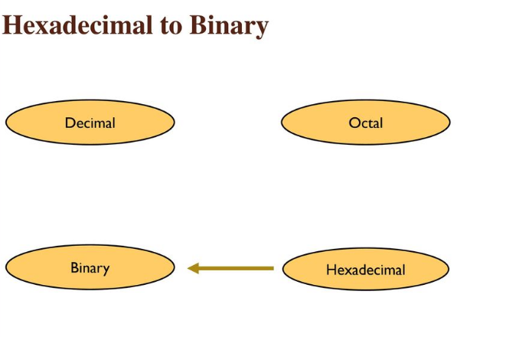

Slide 26
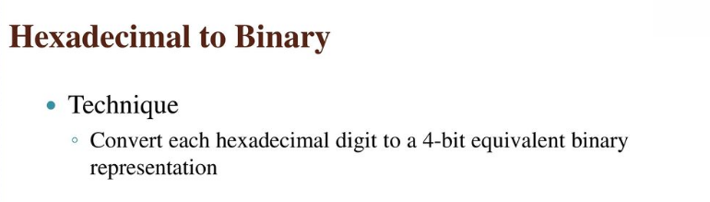
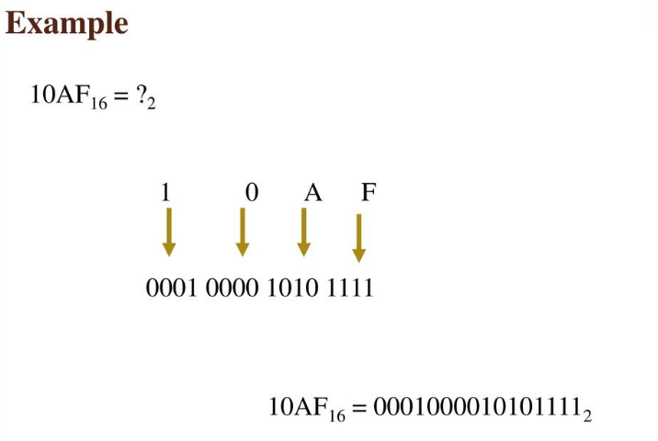

Slide 27
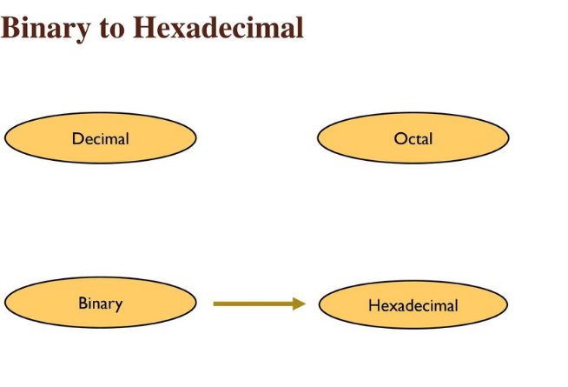

Slide 28
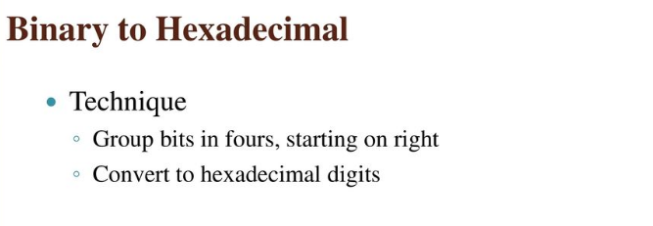
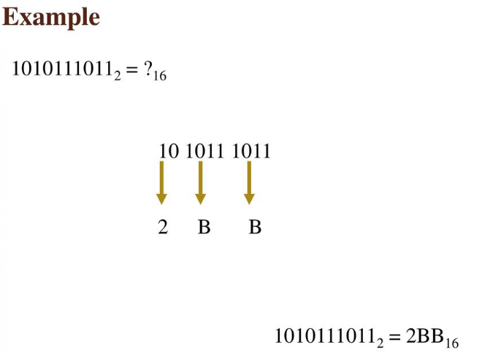

Slide 29
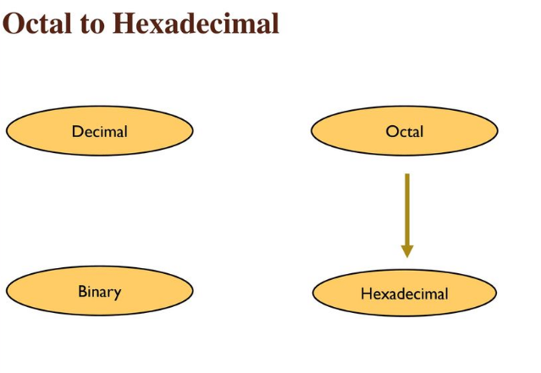

Slide 30
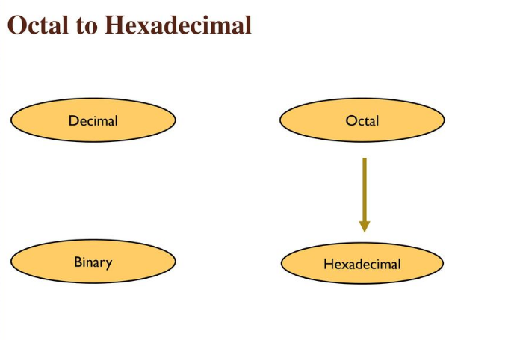

Slide 31
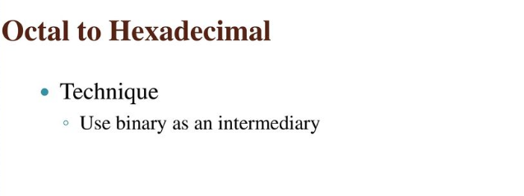
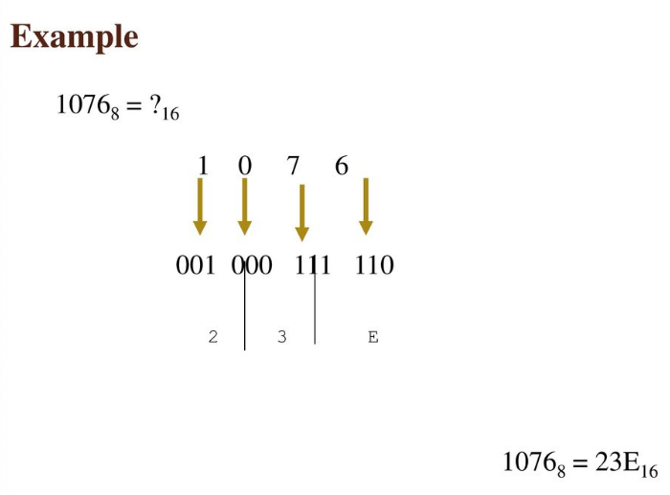

Slide 32
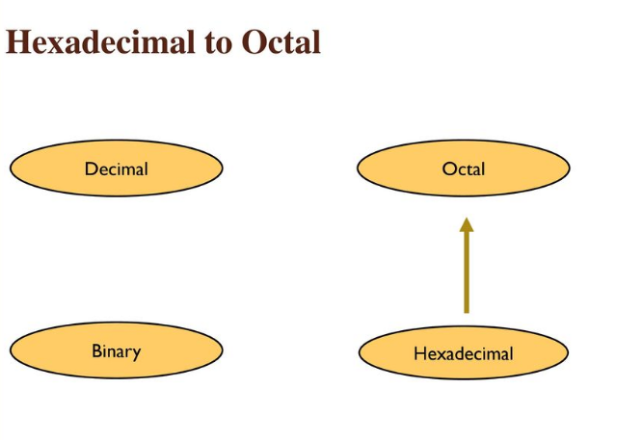

Slide 33
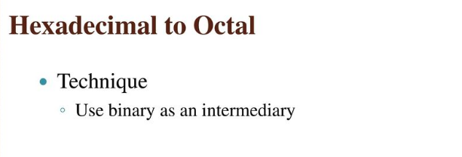
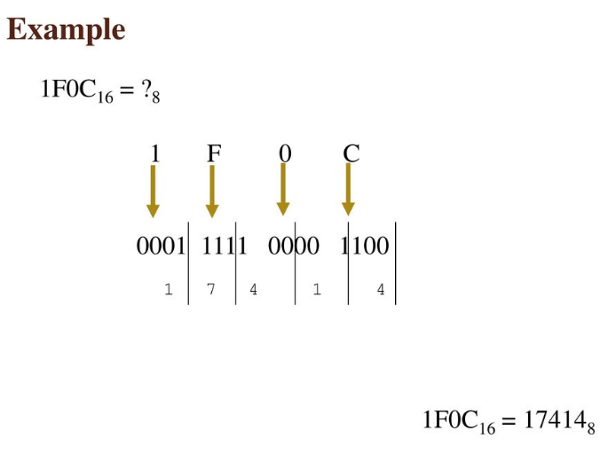

Slide 34
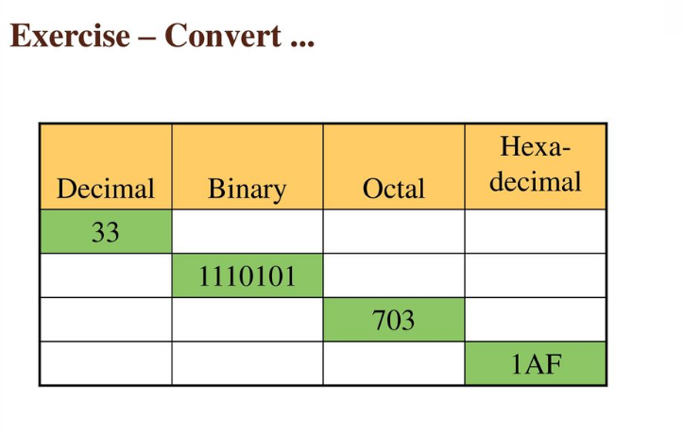

Slide 35
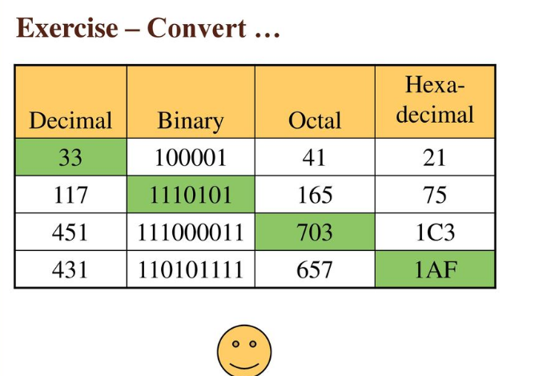

Slide 36
Others | Binary | Octal | Hexadecimal | Decimal
Decimal | ÷2 . x2 | ÷8 . x8 | ÷16 . x16 | N/A
Binary | N/A | Pair of 3 bits | Pair of 4 bits | x2^n
Octal | Break each digit into pair of 3 bits | N/A | Break each digit into pair of 3. Combine into pair of 4 | x8^n
Hexadecimal | Break each digit into pair of 4 bits | Break each digit into pair of 4. Combine into pair of 3 | N/A | x16^n

Slide 37
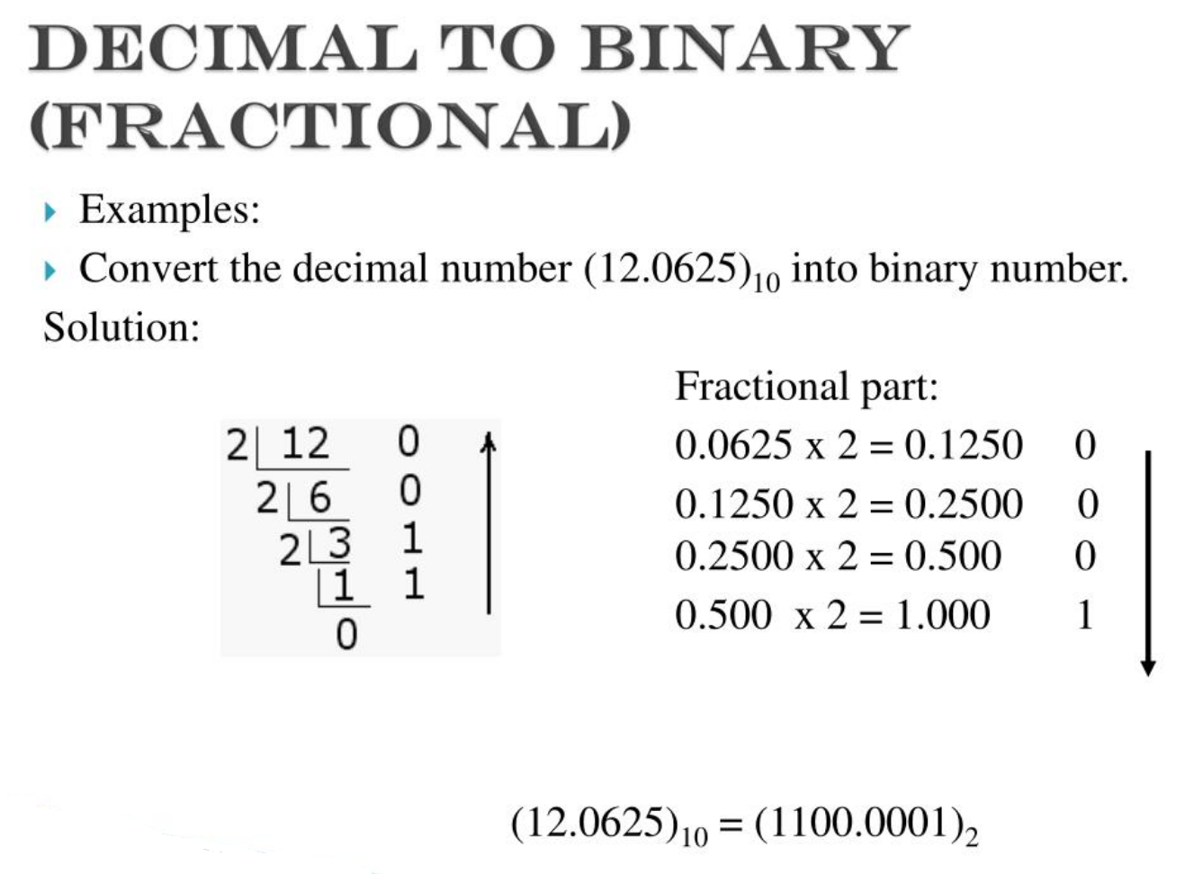

Slide 38
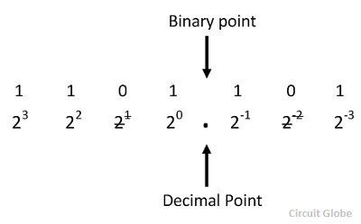
BINARY TO DECIMAL (FRACTIONAL)
Convert (1101.101) into Decimal
+ 4 + 0 + 1 . 0.5 + 0 + 0.125
(13.625) Ans

Slide 39
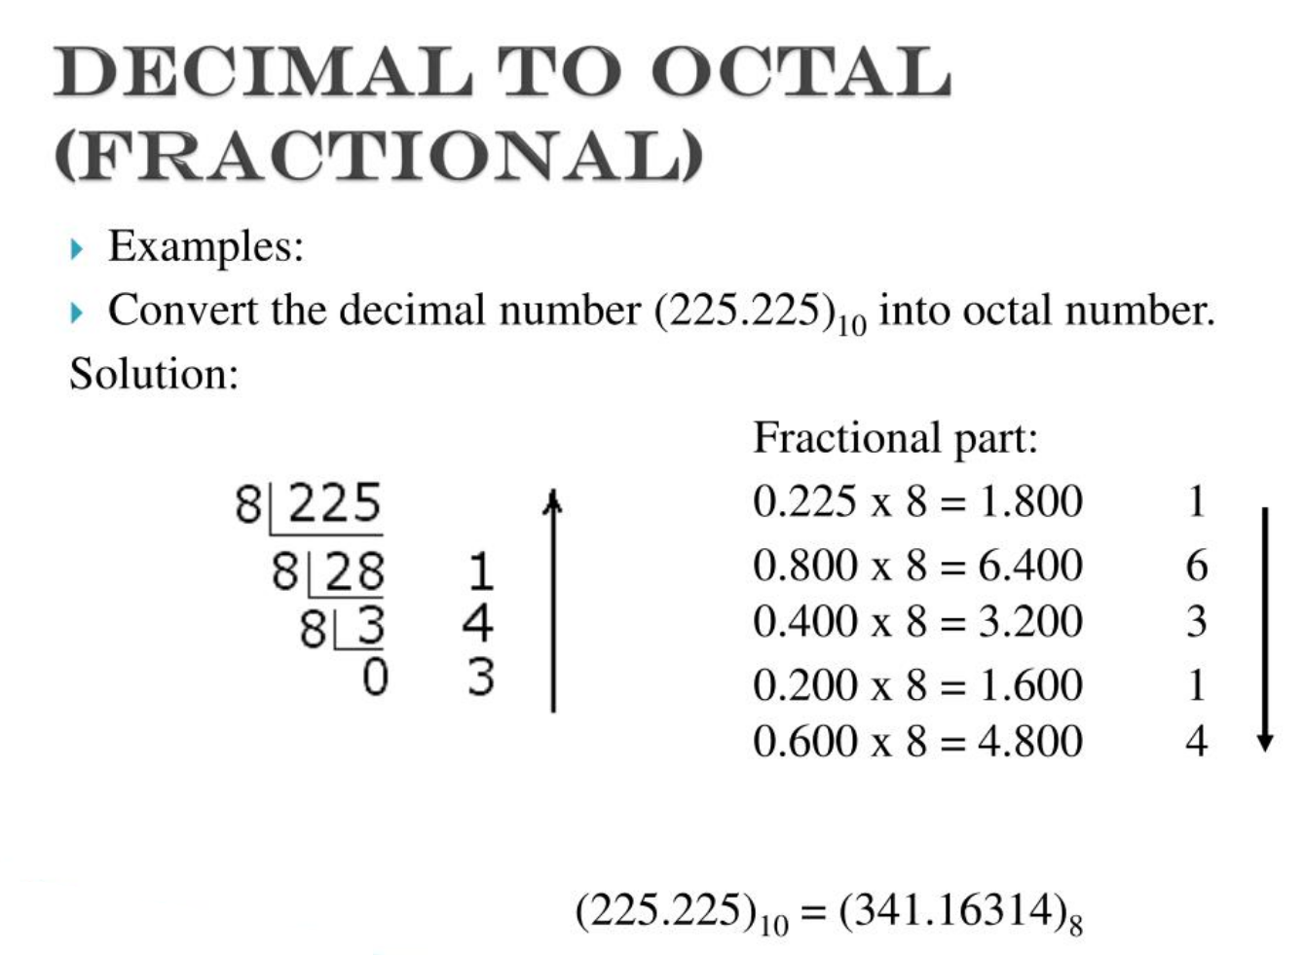

Slide 40
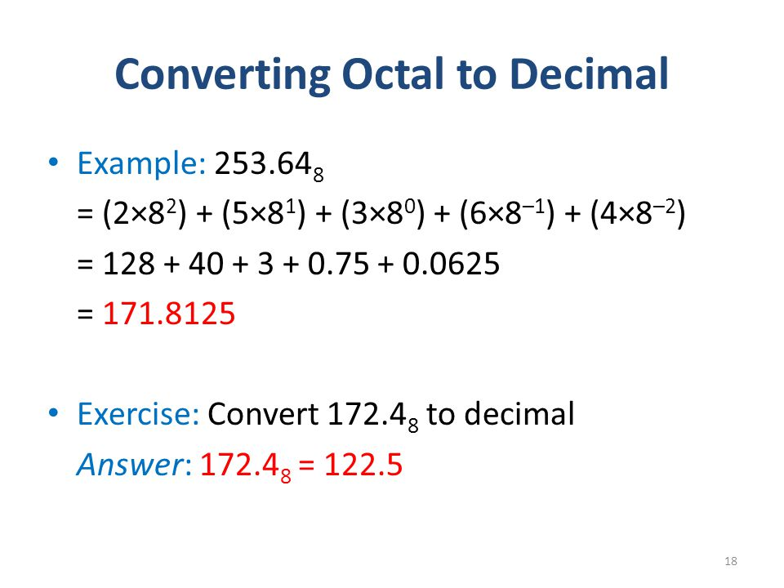

Slide 41
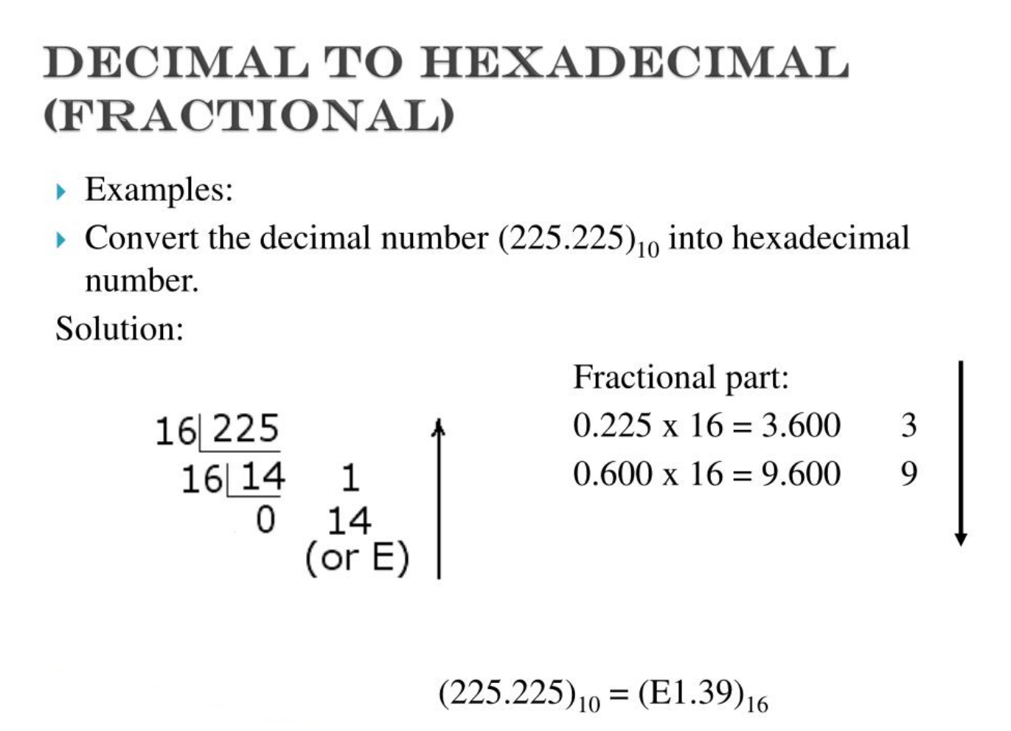

Slide 42

HEXADECIMAL TO DECIMAL (FRACTION)

Slide 43

HEXADECIMAL TO OCTAL (FRACTION)

Slide 44

OCTAL TO HEXADECIMAL (FRACTION)

Slide 45
BINARY ARITHMETIC OPERATION
Binary Addition
Binary Subtraction
Binary Multiplication
Binary Division

Slide 46


Slide 47


Slide 48


Slide 49


Slide 50


Slide 51
Octal Addition
Rules:
Addition of two digits is less then 8 so write that number.
If addition of two digits are equal or greater then 8 then convert it into octal form and pass the carry to next digit as we do in simple math's.

Slide 52



Octal Addition Example

Slide 53

Hexadecimal Addition
Rules:

Slide 54


Hexadecimal Addition Example

Slide 55


Slide 56


Slide 57



Slide 58

SIGNED NUMBER

Slide 59

SIGNED NUMBER REPRESENTATION

Slide 60

REPRESENTATION OF NEGATIVE NUMBER

Slide 61

SIGNED MAGNITUDE REPRESENTATION

Slide 62

SIGNED MAGNITUDE REPRESENTATION

Slide 63

SIGNED MAGNITUDE EXAMPLES

Slide 64

SIGNED MAGNITUDE COMMENTS

Slide 65

COMPLEMENT NUMBER SYSTEM

Slide 66

1’s COMPLEMENT REPRESENTATION

Slide 67

1’s COMPLEMENT EXAMPLES

Slide 68

1’s COMPLEMENT COMMENTS

Slide 69

2’s COMPLEMENT REPRESENTATION

Slide 70

2’s COMPLEMEWNT EXAMPLES

Slide 71

2’s COMPLEMENT COMMENTS

Slide 72

ARITHMETIC OPERATION WITH SIGNED NUMBERS

Slide 73

ADDITION

Slide 74

CASE I

Slide 75

CASE II

Slide 76

CASE III

Slide 77

CASE IV

Slide 78

OVERFLOW CONDITION
When two numbers are added & numbers of bits required to represent sum exceeds the number of bits in the two numbers, an overflow results as indicated by an incorrect sign bit.
Overflow occur when two positive numbers or two negative numbers are added.
Example

Slide 79
SIGNED NUMBER SUBTRACTION
Subtraction is a special case of addition.
The signed of positive or negative binary number is changed by taking its 2’s complement
To subtract two signed numbers, take the 2’s complement of the subtrahend & add. Discard any final carry bit

Slide 80

EXAMPLES

Slide 81

EXAMPLES

Slide 82

MULTIPLICATION OF SIGNED NUMBERS

Slide 83

Example

Slide 84


Slide 85


Slide 86

DIVISION OF SIGNED BINARY NUMBERS

Slide 87

Example

Slide 88


Slide 89

Hexadecimal Subtraction

Slide 90

Hexadecimal Subtraction

Slide 91

Hexadecimal Subtraction

Slide 92

Hexadecimal Subtraction Example

Slide 93

BINARY CODED DECIMAL (BCD)

Slide 94
THE 8421 BCD CODE
BCD stands for Binary-Coded Decimal.
A BCD number is a four-bit binary group that represents one of the ten decimal digits 0 through 9.
Example:
Decimal number 4926 4 9 2 6
8421 BCD coded number 0100 1001 0010 0110

Slide 95
TEST
Convert the BCD coded number
1000 0111 0001 into decimal.
BCD Coded Number 1000 0111 0001
Decimal Number 8 7 1

Slide 96
TEST
Convert the decimal number 350 to its BCD equivalent.
Decimal Number 3 5 0
BCD Coded Number 0011 0101 0000

Slide 97

BCD ADDITION

Slide 98

EXAMPLE

Slide 99


Slide 100
THE GRAY CODE
The Gray code’s most important characteristic is that only one digit changes as you increment or decrement the count.
The Gray code is commonly associated with input/output devices such as an optical encoder of a shaft’s angular position.
The Gray code is NOT a BCD code.
Decimal Gray code
0 00000
1 00001
2 00011
3 00010
4 00110
5 00111
6 00101
7 00100
8 01100
9 01101
10 01111
11 01110
12 01010
13 01011
14 01001
15 01000
16 11000

Slide 101



Slide 102


Slide 103

Application

Slide 104

Floating-Point Numbers (Single-Precision Floating-Point Binary Number)
Standard Form

Slide 105

Example

Slide 106

Example

